Slide 1
Buttons

Slide 2

Buttons

Slide 3

Button colors

Slide 4

Colored Button Borders

Slide 5

Hoverable Buttons

Slide 6

Button Groups

Slide 7

Animated Buttons - “Pressed Effect”

Slide 8
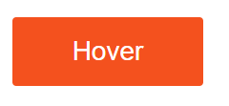
Arrow animated Buttons

Slide 9

Fading Buttons

Slide 10

Animated Button - Ripple effect

Slide 11

Disabled Buttons

Slide 12

Shadow Buttons

Slide 13
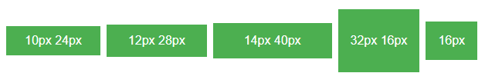
Button sizes

Slide 14
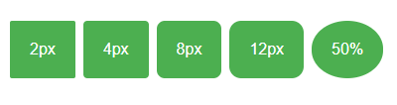
Rounded Buttons

Slide 15
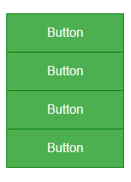
Vertical Button Group

Slide 16
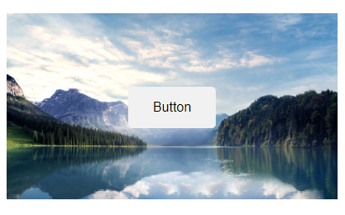
Button on Image

Slide 17
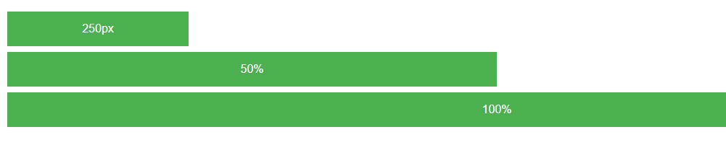
Button width

